Slide 1
Indoor plantation as a sources of recreation and a source of income
Date of presentation – 28 July 2021

Slide 2
Submitted to :
Course Instructor : Syeda Shabnam Mahmud
Depertment : Depertment of English
Course Title : Composition and Communication Skill
Course Code : ENG102
Section - 13

Slide 3



Submitted by :
Name :Nazat Amin Khan Depertment : Civil Engineering Roll: 2020-2-22-024
Name : Anika Mobashera Depertment : Computer Science and Engineering Roll : 2021-1-60-130
Name : Jannatul Ferdous Anika Sheikh Depertment : Electrical and Electronics Engineering Roll : 2020-2-80-027

Slide 4
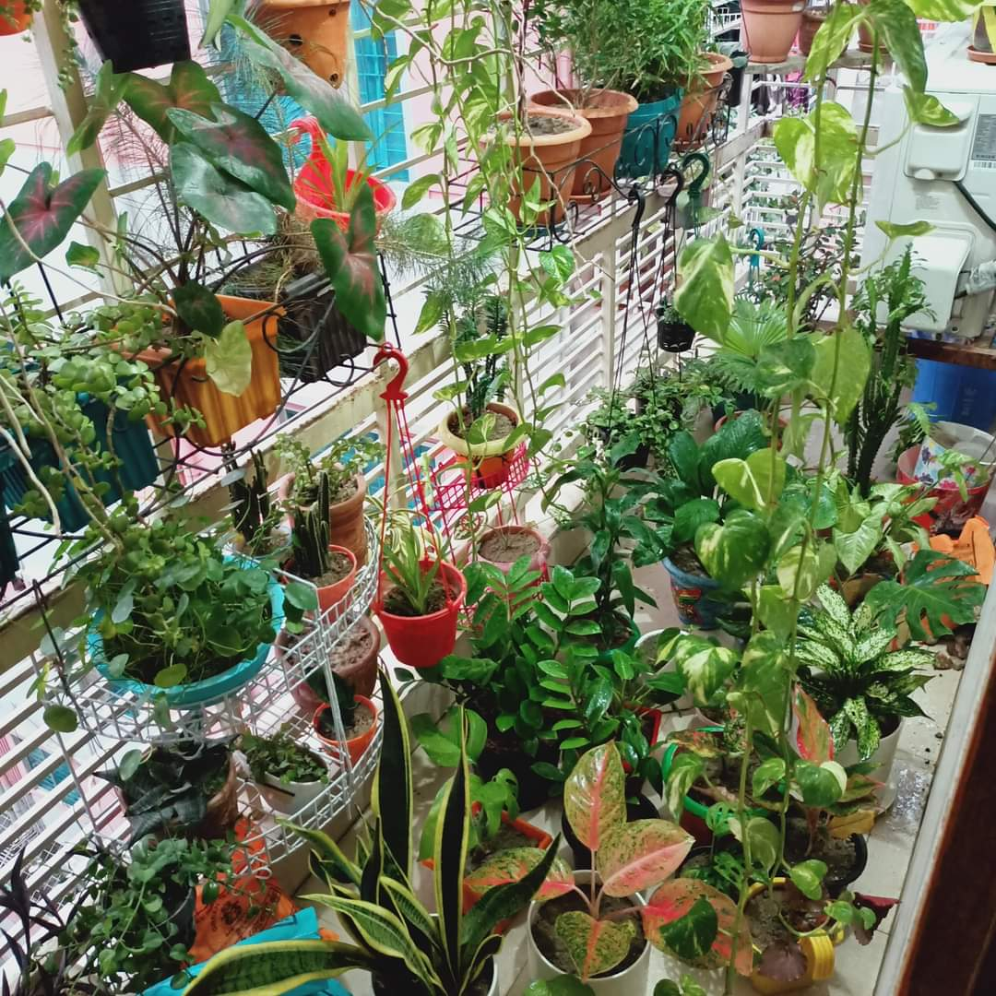
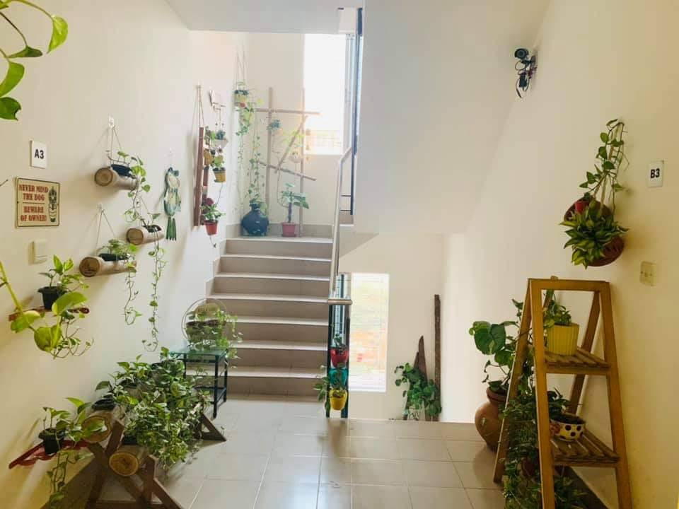
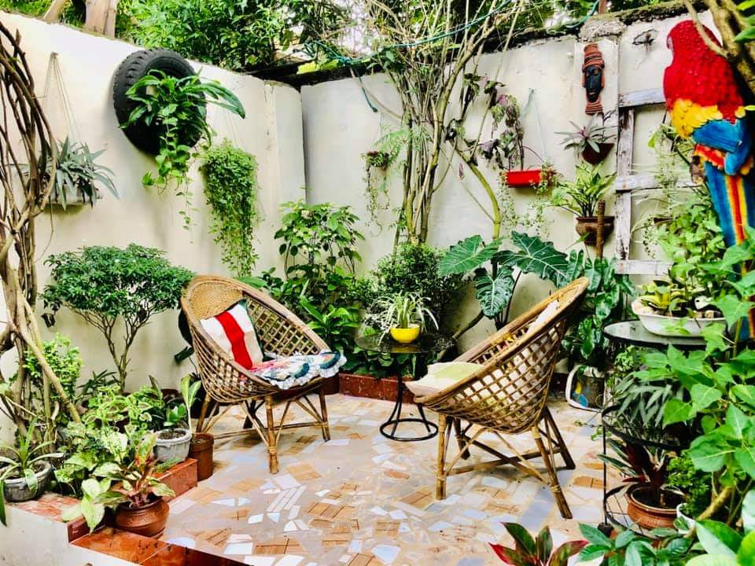
Introduction::
Indoor plantation is a kind of plantation that is cultivated by people at indoors in places. People do this as a hobby, to keep themselves busy, as a medium of recreation and as a purpose of income. Homesick people and housewives are the main to introduce this new era of earning.

Slide 5
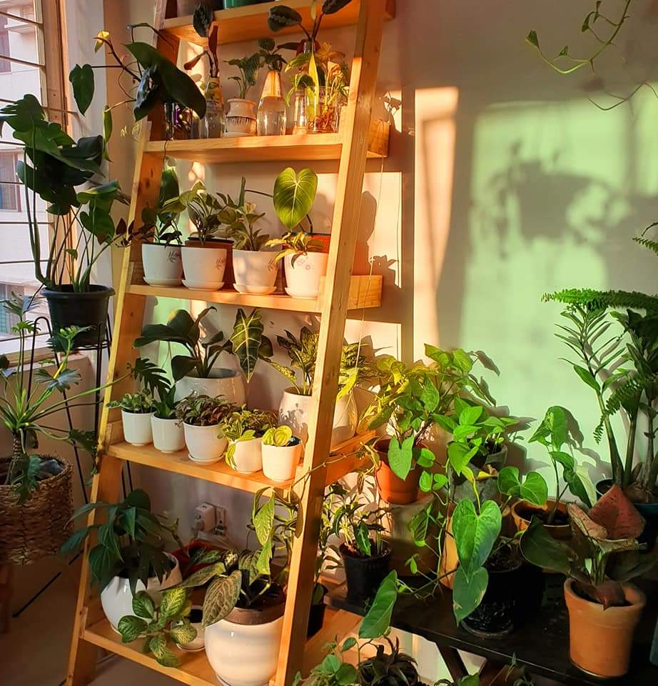
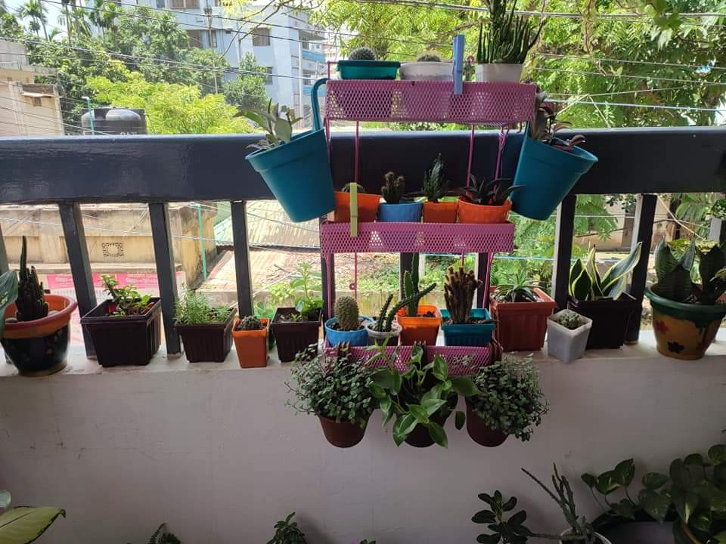
Justifying of choosing the topic:
Good for environment ‌Indoor work
Way of recreation ‌Helps economically

Slide 6
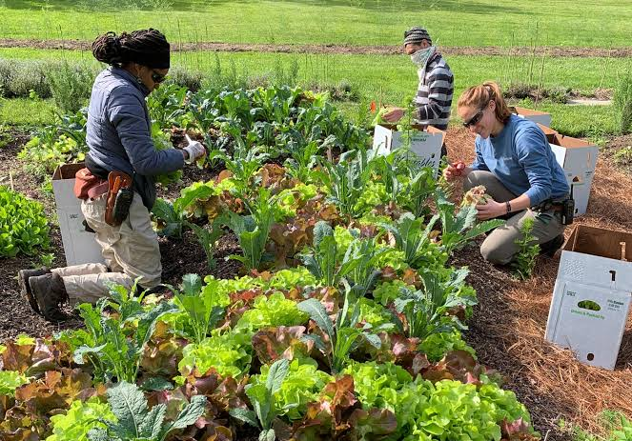
How would we execute our plan of research :
Three members of our team will work to prepare a term paper on “indoor plantation as a source of recreation and income” Data collection is the process of assembling data from all the applicable sources and interview to find answers to research problems, hypothesis, testing and analysis of the results. When we gather all the information, then we have to combine everything and complete our term paper. Doubts or disagreements will be discussed until full consensus is reached.

Slide 7
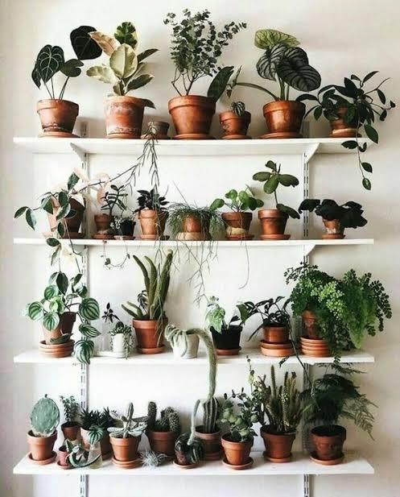

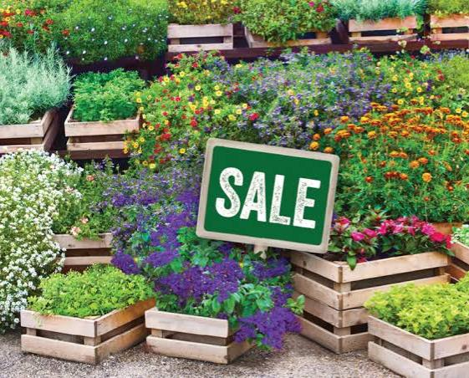
Reserch Question :
Which plants are good for indoor plantations? ‌How can anybody profit economically from indoor plants? ‌How can indoor plants reduce psychological stress and can work as a source of recreation?

Slide 8
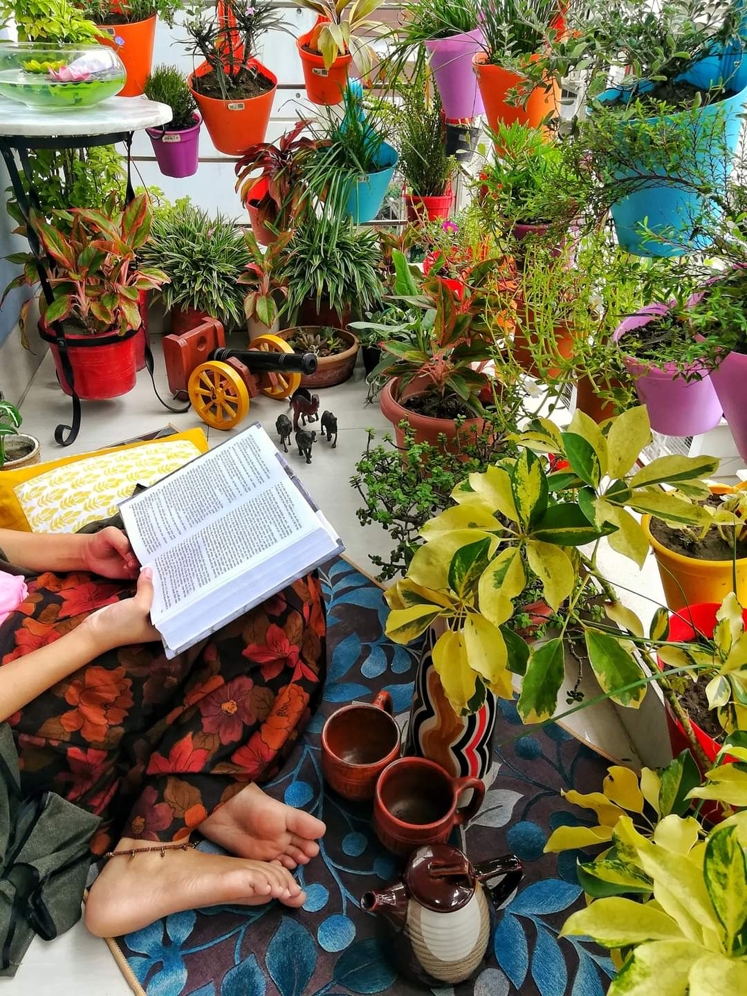
Sample question for our survey :
Why did you start an indoor plantation? ‌What motivated you to do indoor plantation? ‌What types of trees do you have? ‌How do you manage or take care of them as they have individual needs? ‌How costly it is to maintain indoor plants? ‌How you getting economically benefitted with these?

Slide 9
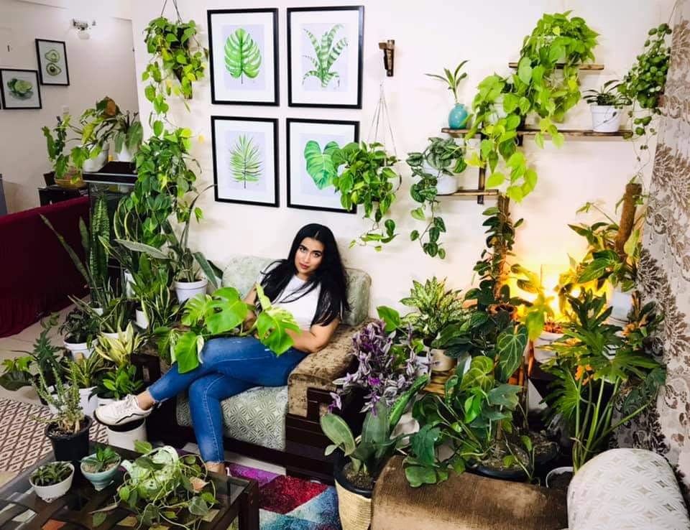
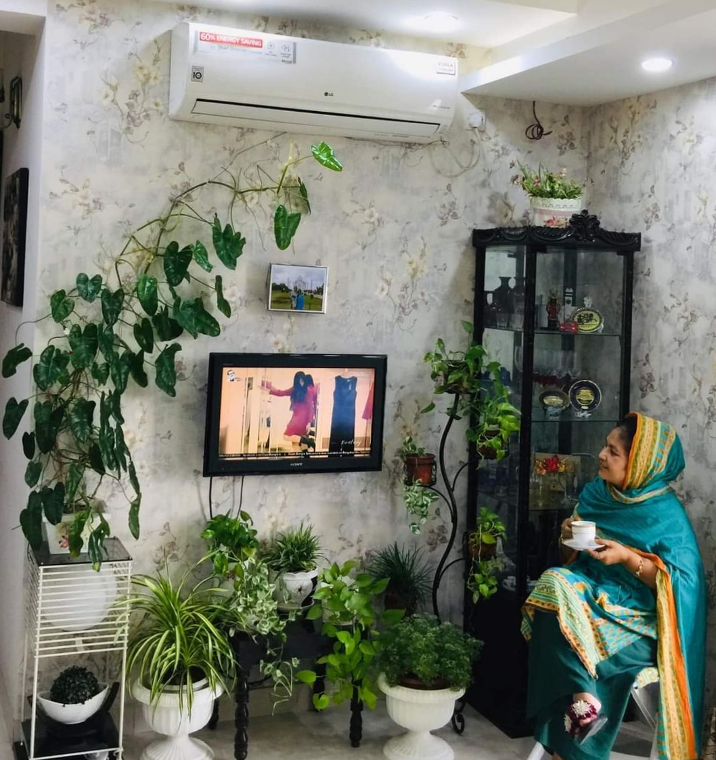
The background of the interviewers :
1.
Name : Muntasir Ahmed Abbas
Age : 23
Profession : Student of L.L.B. In Dhaka University and admin of Facebook group“Indoor Plants Bangladesh“
Location : Santinogor, Dhaka
2.
Name : Nazma Begum
Age 55
Profession : House wife
Location : Tejgaon, Dhaka
3.
Name Farhana Karim
Age : 34
Profession : Gurdren Business and Teacher
Location : Khilgaon,Dhaka

Slide 10
Two journal articles link that we will use as a reference in our paper :
Medinilla: an exotic and attractive indoor plant with great value ( link -https://scholar.google.com/scholar?hl=en&as_sdt=0%2C5&) indoor+plants+as+a+source+of+income&btnG=#d=gs_qabs&u=%23p%3Dub8GKggKKdIJ )
The psychological benefits of indoor plants: A critical review of the experimental literature ( link – https://scholar.google.com/scholar?hl=en&as_sdt=0%2C5&q=indoor+plants+as+a+source+of+recreation&btnG=#d=gs_qabs&u=%23p%3Dn_PbTPbWrZUJ)

Slide 11
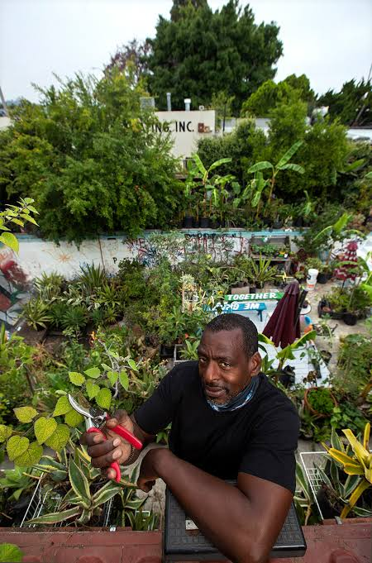
How is the term paper is going to benefit others :
In research, it has been observed that indoor plantation can be beneficial in many ways. Plantation is good for the environment and also a great recreation source. It reduces psychological stress and has physiological benefits. Everyone can earn money by doing indoor plantation. By doing indoor plantation, we will get a great outlook of our interior and it is also time consuming. Furthermore, the study results indicated that indoor plants are a source of recreation and income.

Slide 12
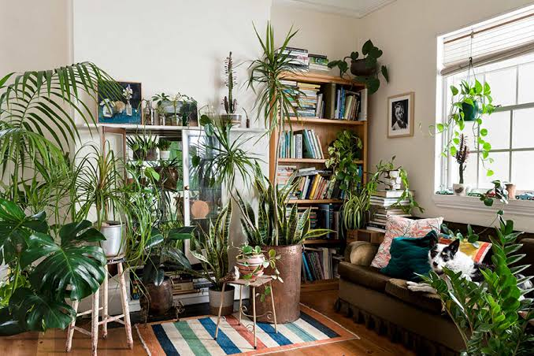
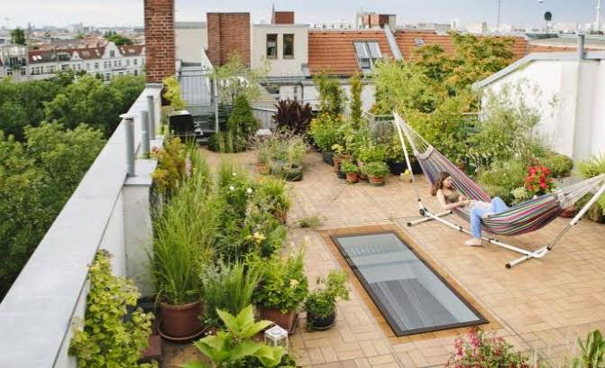
Thank You

